Slide 1




Slide 2
By the end of this module, you will be able to...
Recognize opportunities for improvement and generate creative ideas for change
Develop and test an idea for change using PDSA cycles
Consider ways to sustain improvement over time

Slide 3
IDEAS FOR CHANGE
Not all changes result in improvement
Often we need a number of different ideas to achieve our aim
Ideas for change come from various sources

Slide 4
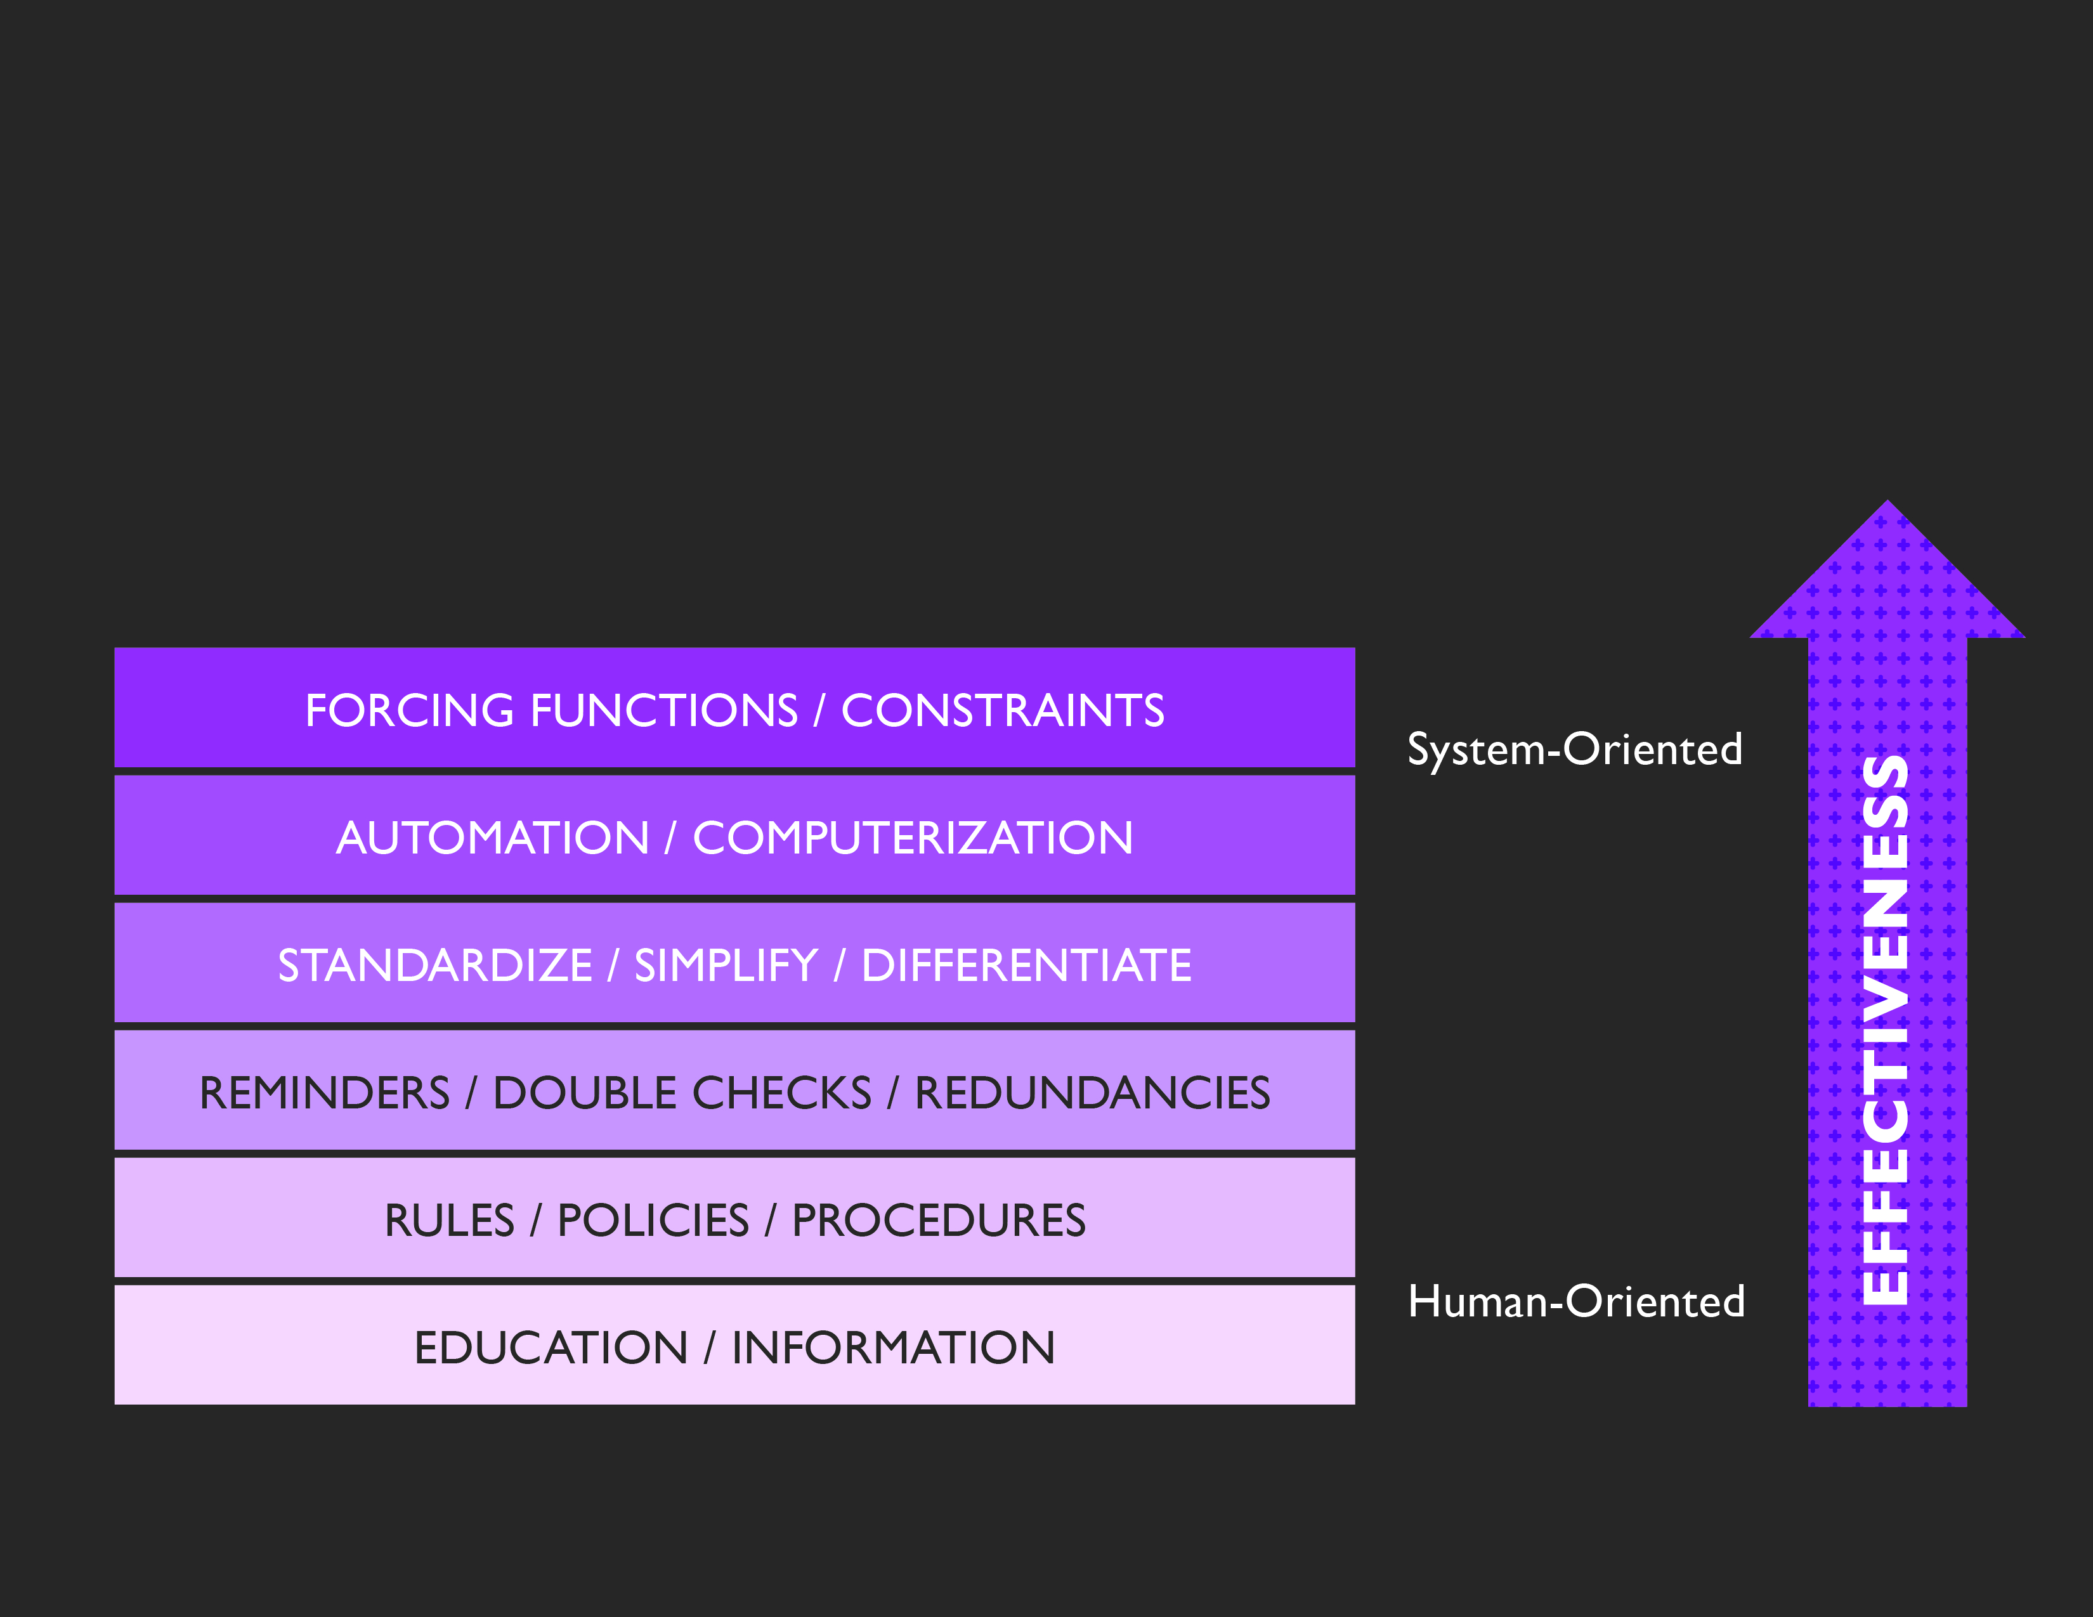
EFFECTIVENESS OF CHANGES
Some kinds of changes are typically
more effective than others
  (Institute for Safe Medication Practices, 1999)

Slide 5
METHODS TO GENERATE
CHANGE IDEAS
Adapting Best Practices
Change Concepts
Mapping
Creativity of the Team

Slide 6
ADAPTING BEST PRACTICES
Research/Literature Review
Guidelines
Benchmark

Slide 7
CHANGE CONCEPTS
A general approach found to be useful in developing specific ideas for change that results
in improvement.

Slide 8
MAPPING
A visual depiction of a process.
Maps highlight:
Unnecessary delays
Unnecessary steps or transitions
Duplication of effort (waste)
Things that don't make sense
Hotspots, bottlenecks, or constraints

Slide 9
CREATIVITY OF THE TEAM
Use novel ways of thinking to generate ideas
for change.

Slide 10
ONCE CHANGES ARE IDENTIFIED…
Test on a small scale
Collect data over time
Build knowledge sequentially and
include a wide range of conditions

Slide 11
WHY DO WE NEED
PDSA CYCLES?
Because we don’t know:
How well an idea will work
How the idea is best delivered
If it will work in all conditions
When it won’t work
How it will affect other parts of the system

Slide 12
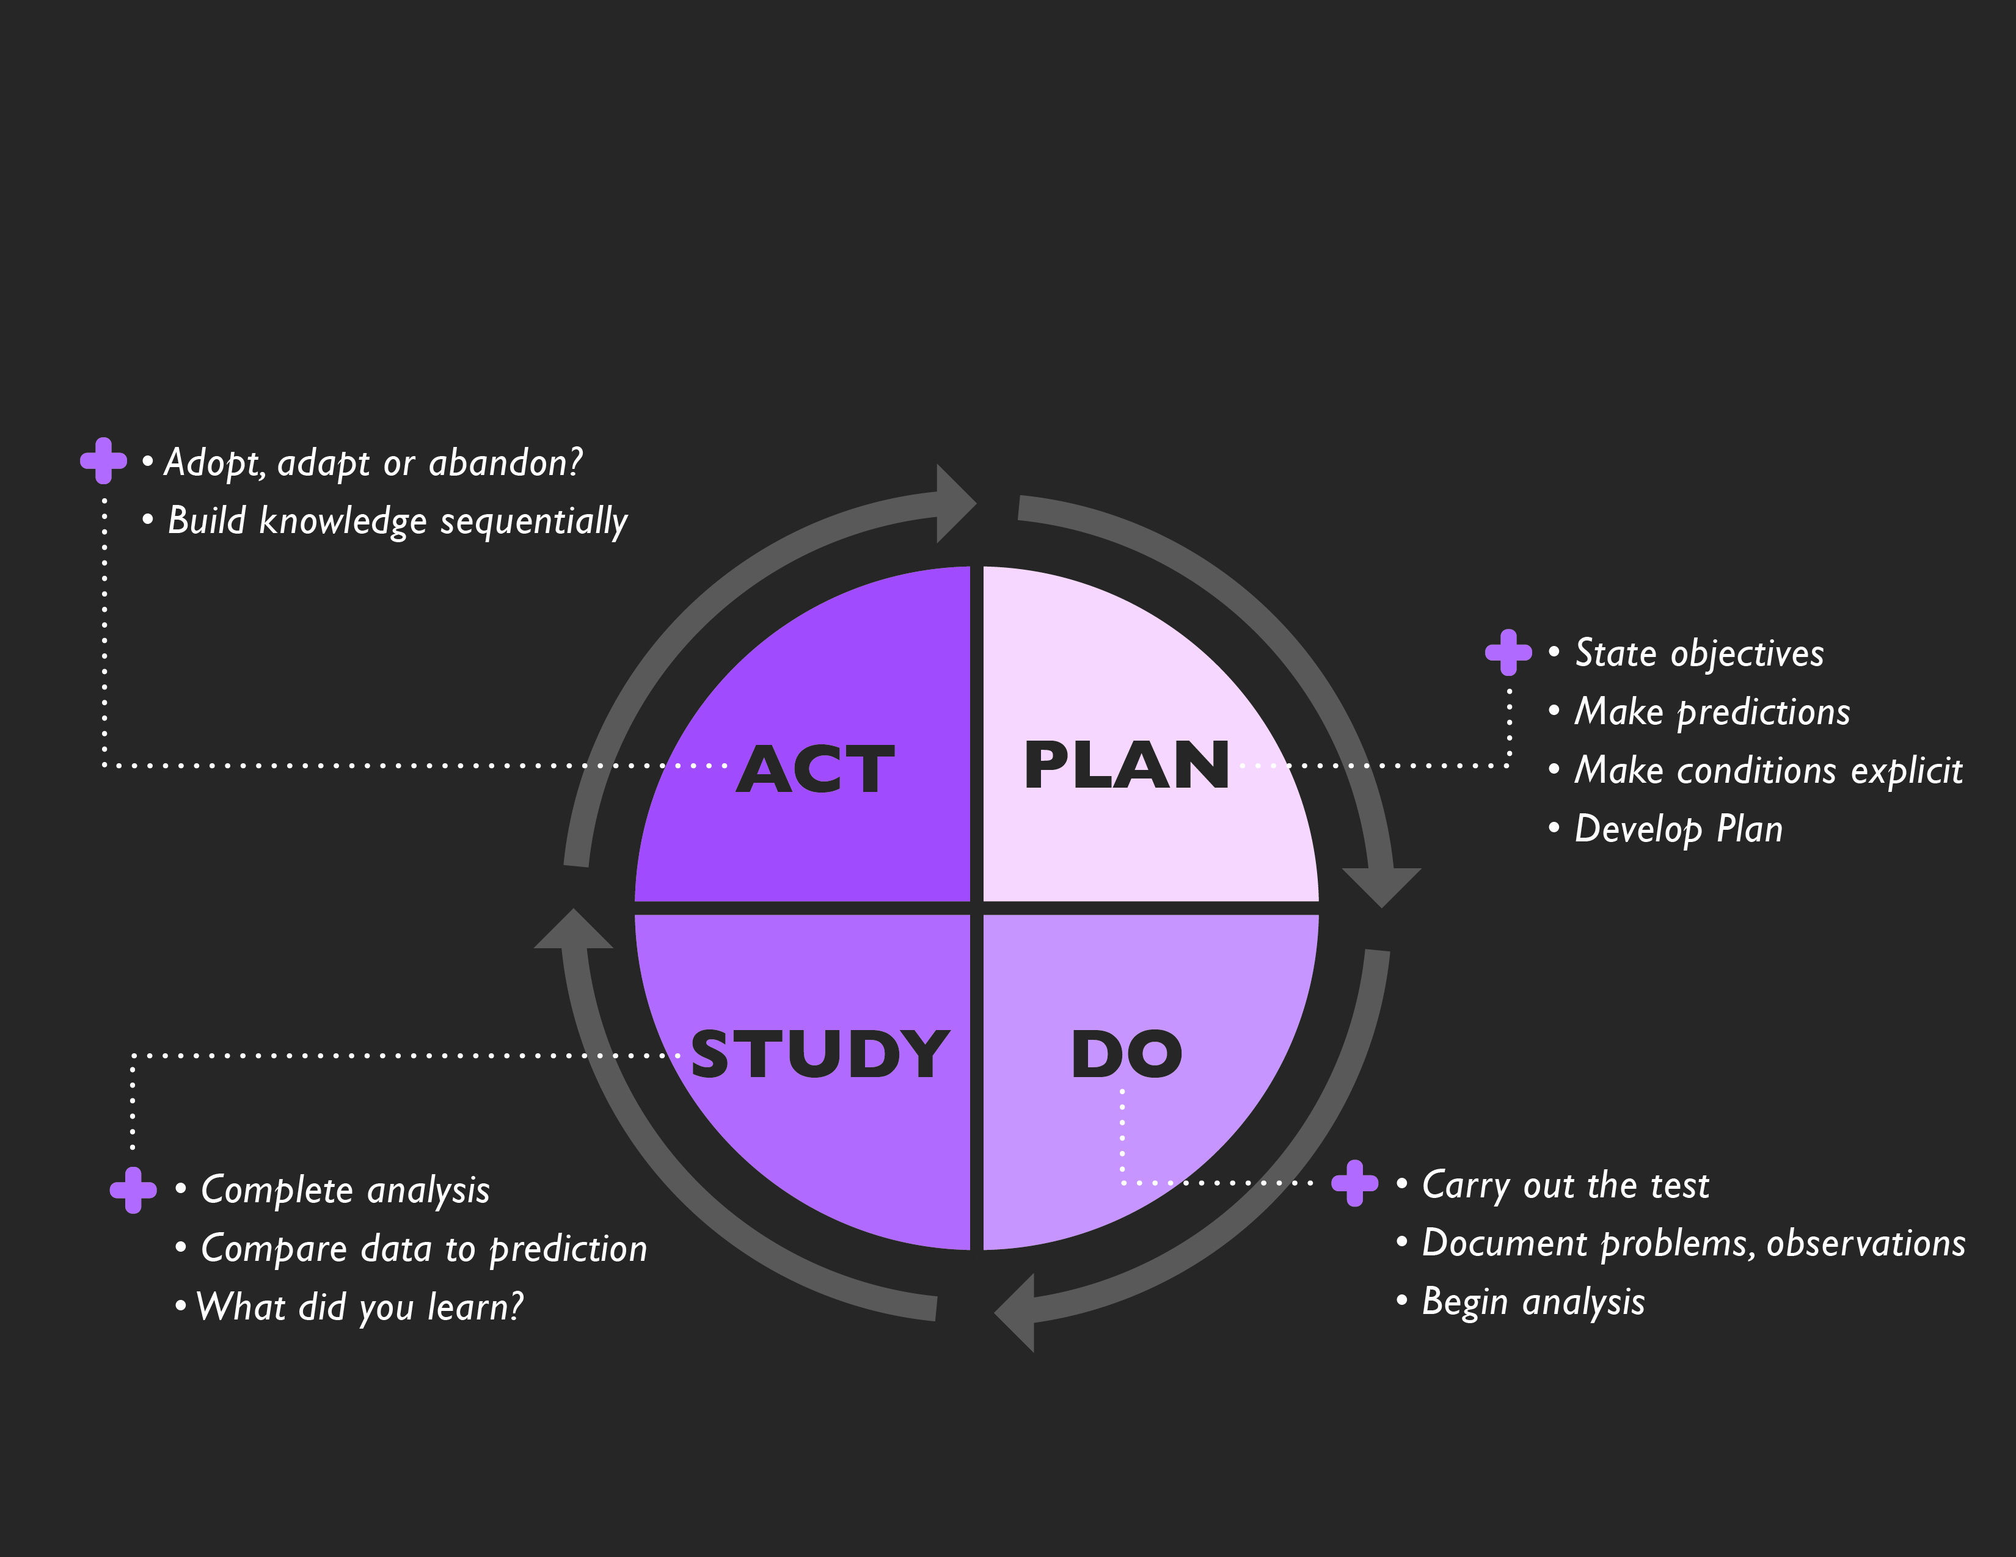
PDSA CYCLE
  (Adapted from Langley et al, 2009)

Slide 13
AIM STATEMENT
“The wait time for the Get Better Clinic will decrease from an average of 135 days to 60 days by the end of this year.”
CHANGE IDEA
Modify clinic hours.

Slide 14
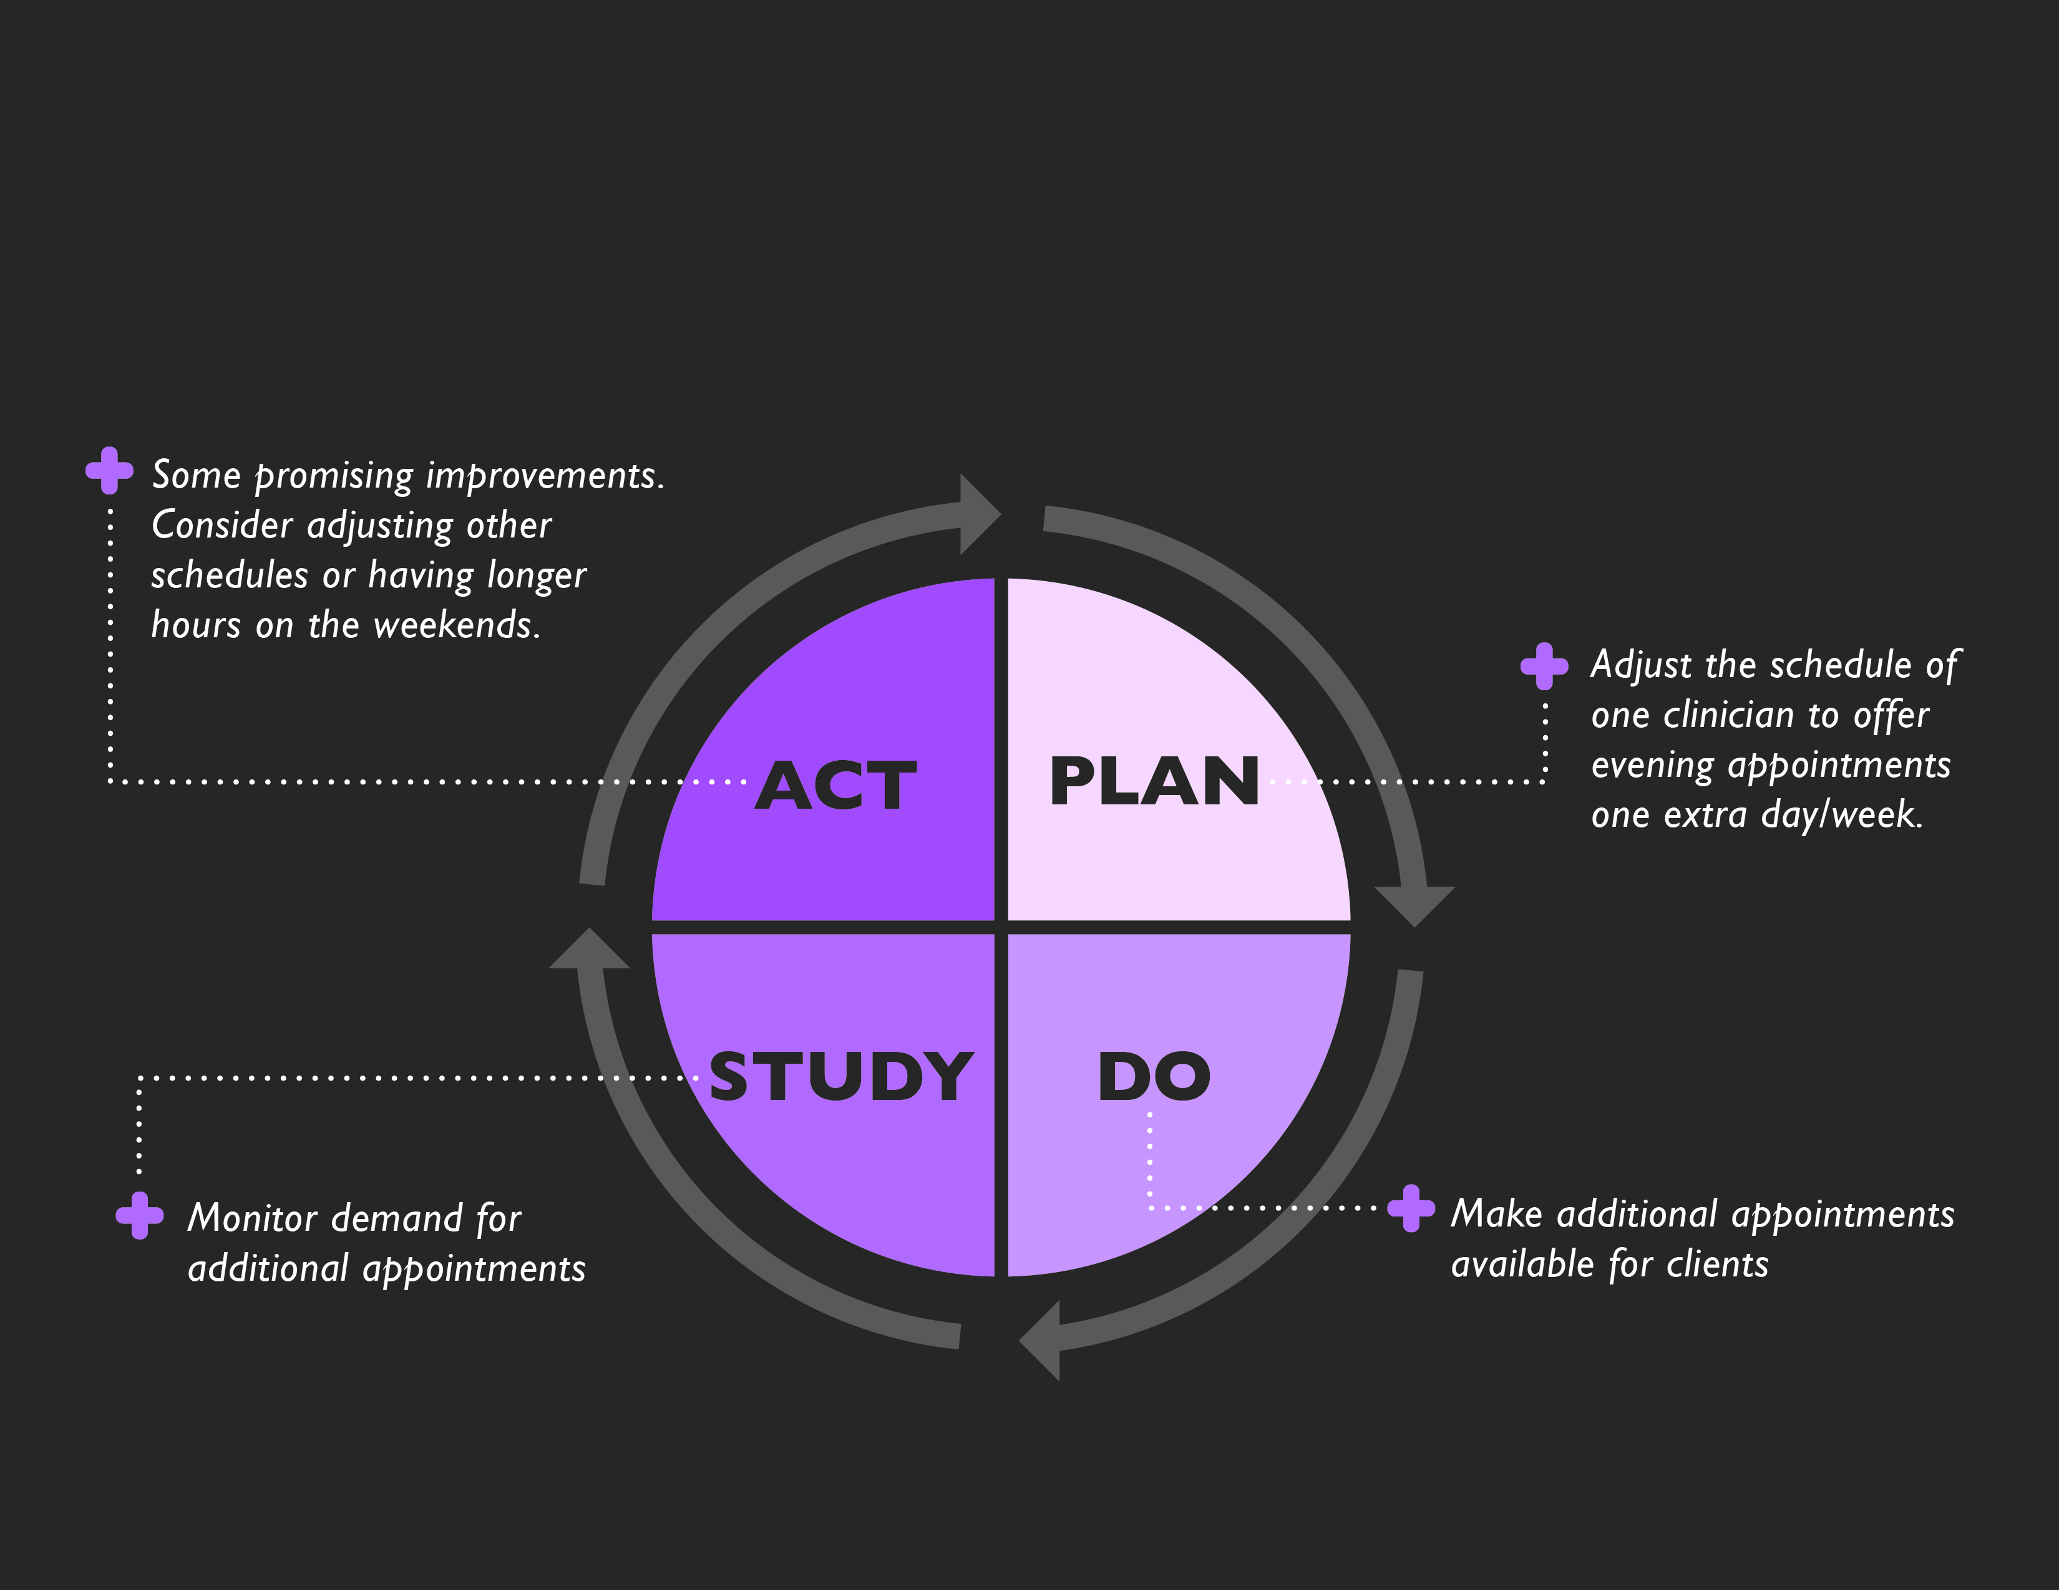
PDSA CYCLE

Slide 15
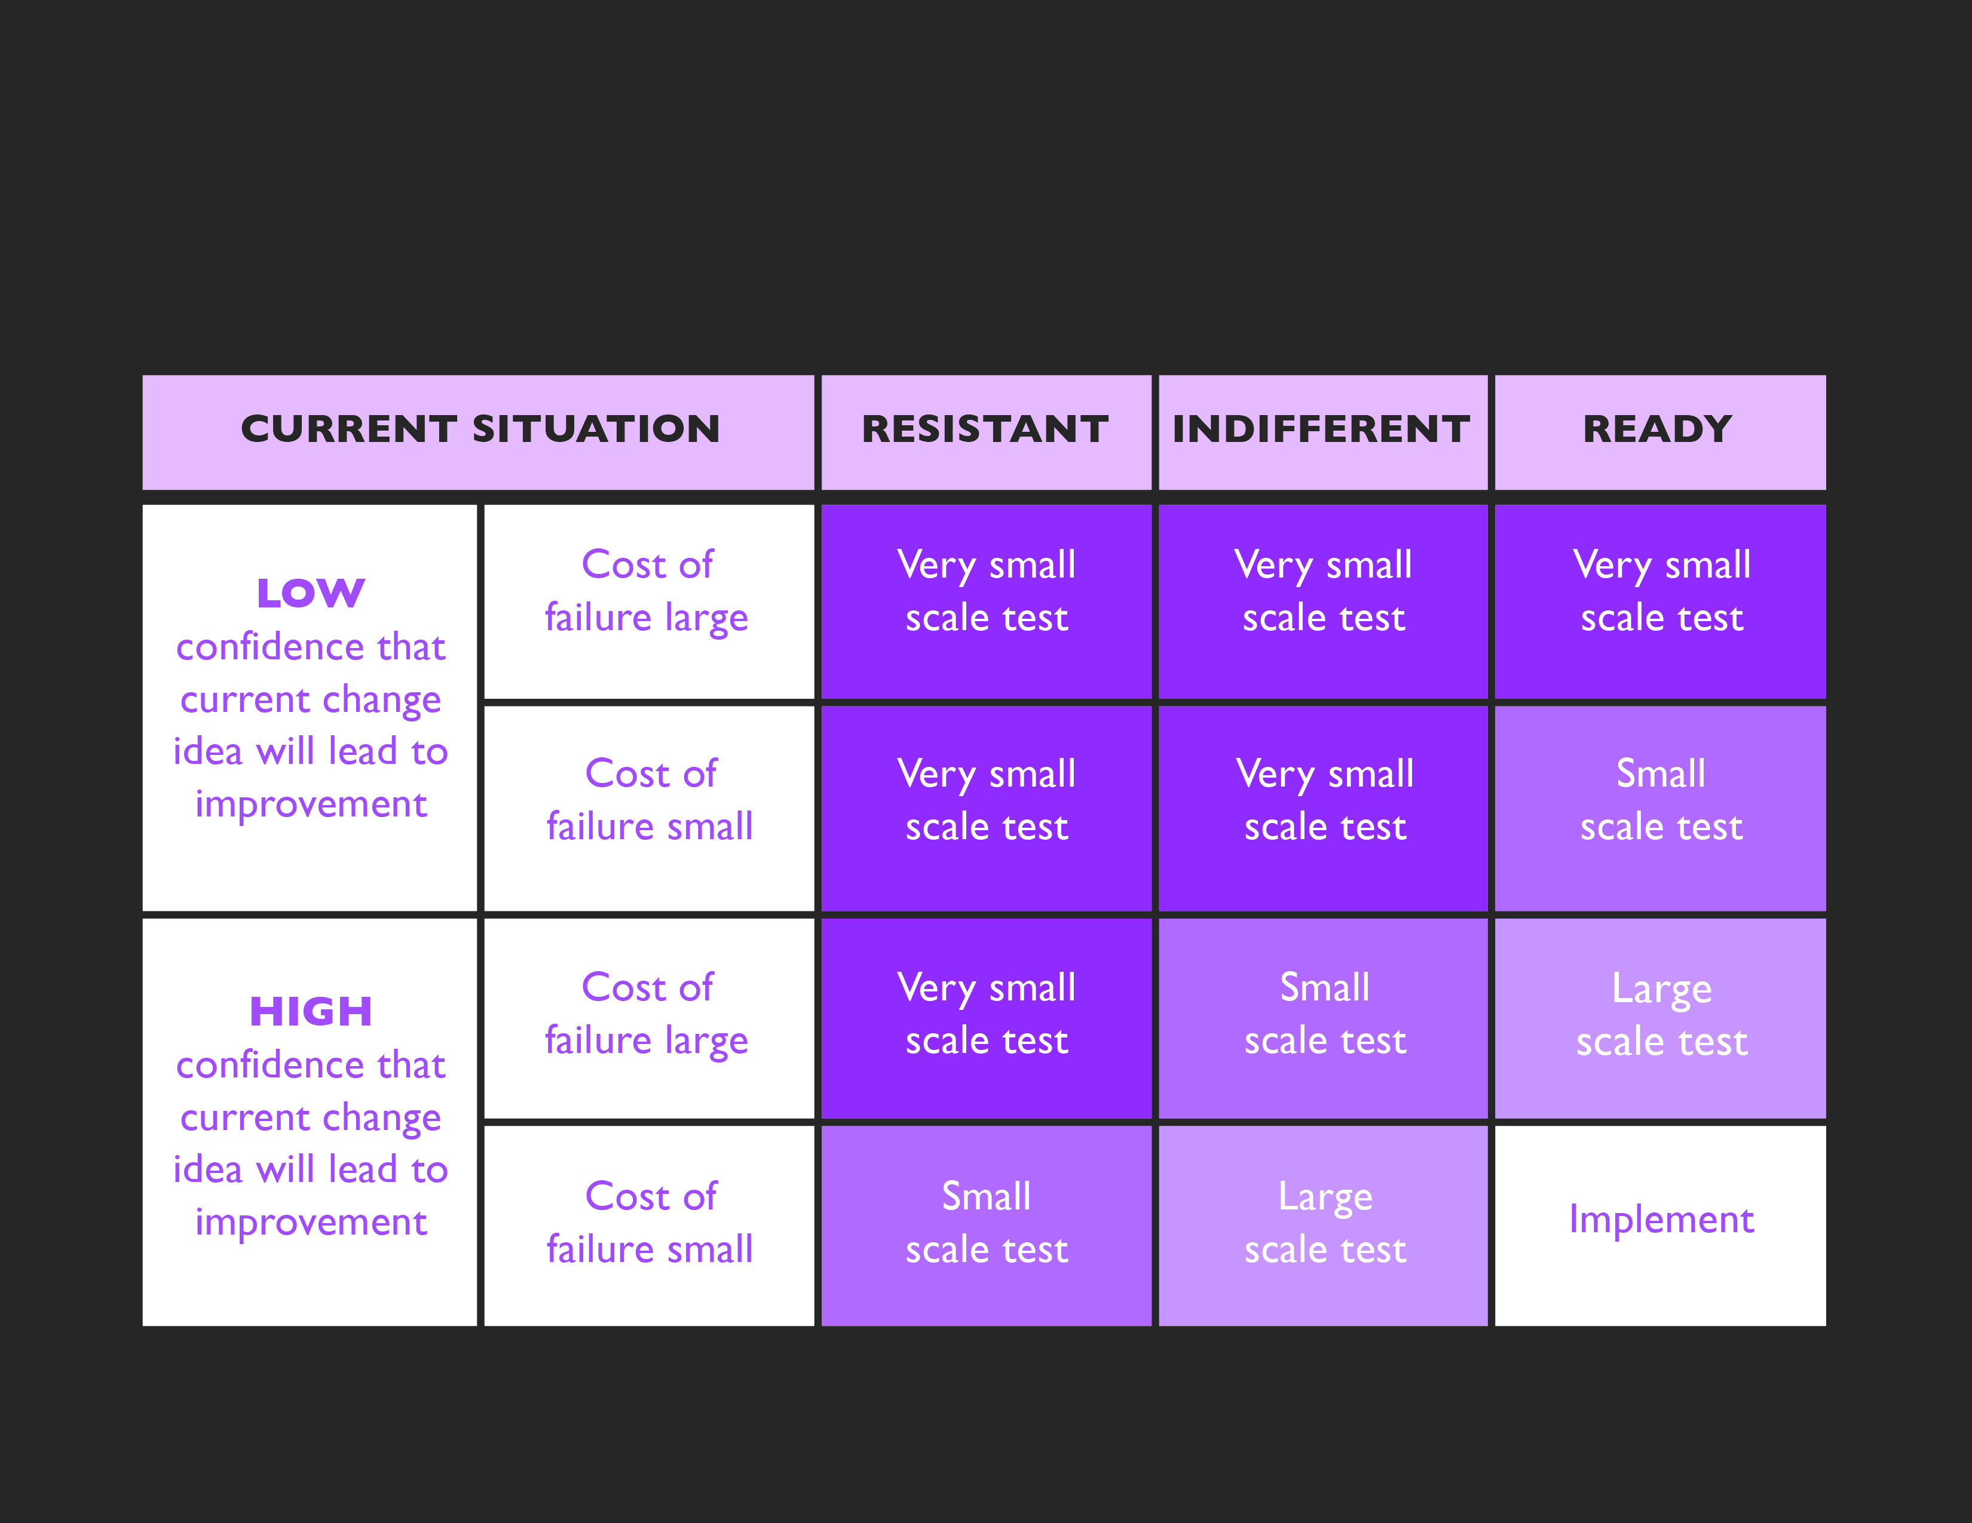
HOW BIG OF A CYCLE?
  (Adapted from Langley et al, 2009)

Slide 16
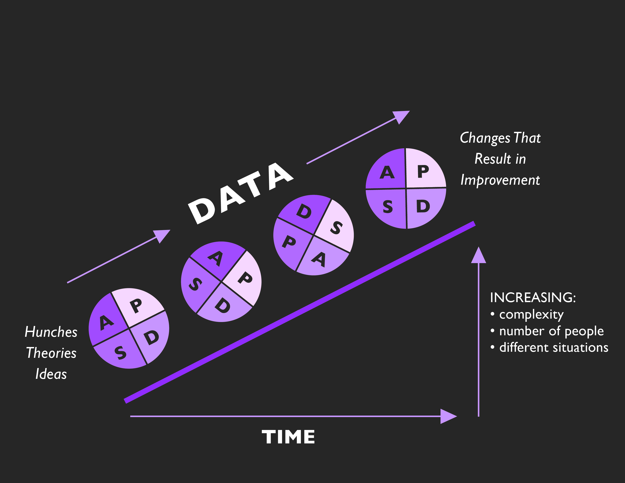
REPEATED USE OF THE PDSA CYCLE
  (Adapted from Langley et al, 2009)

Slide 17
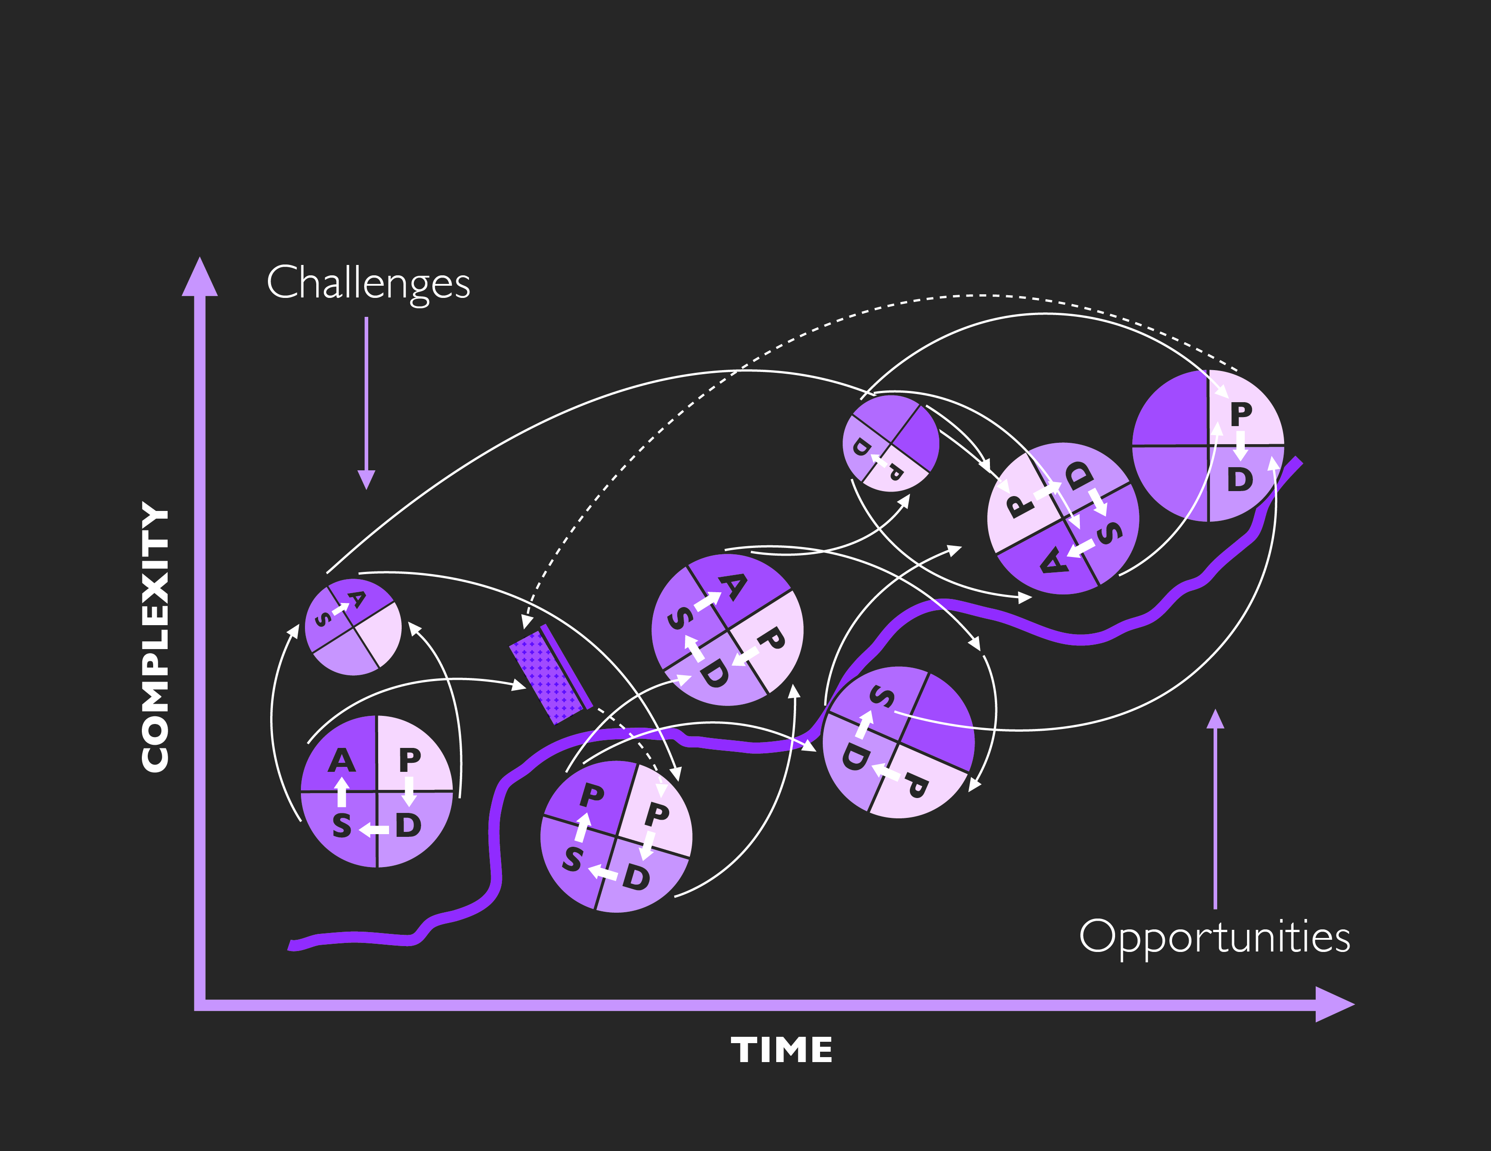
PDSA REALITY

Slide 18
TEST UNDER DIFFERENT CONDITIONS
Different employees
New employees
Different patient groups
Complex patients
Day shift vs. night shift
Hours of the day
Days of the week

Slide 19
HOW LONG WILL IT TAKE?
YEARS
MONTHS
WEEKS
DAYS
HOURS
MINUTES

Slide 20
SUSTAINABILITY
When new ways of working and improved outcomes become the norm...and stay the norm!
  (NHS Institute for Inonvation and Improvement, 2010)

Slide 21
KEEP IN MIND…
Testing helps you learn about whether a change was effective
You may predict that the test will fail – this is good for learning too
Documenting PDSA cycles ensures that cycles are actually tests of change, not simply activities or tasks
It is important to plan for sustainability at the outset

Slide 22
TIME TO REFLECT
Can you...
Recognize opportunities for improvement and generate creative ideas for change?
Develop and test an idea for change using PDSA cycles?
Consider ways to sustain improvement over time?

