Slide 1

Change Day 2017
1 Day. 5000 Pledges. Unlimited Possibilities

Slide 2
November 17, 2017
BCPSQC, along with our partners, is planning another Change Day on November 17, 2017 (17.11.17)
Together, we’ll build on the success of our first Change Day when we hoped for 5000 pledges and received close to 8000 from across BC!
We invite you to join us in doing it again!

Slide 3

What is Change Day all about?
Change Day invites anyone involved in health, social, and community care to commit to making a change or trying something new to make our system better for British Columbians.

Slide 4
What is our goal?
Our goal is to collect 5000 pledges from now until Change Day on 17.11.17.

Slide 5
Who can pledge?
Patients, residents, clients, families, or those working in the health and care system are all invited to participate.

Slide 6
What is a pledge?
A pledge is something that you commit to doing, changing or improving in health, social and/or community care.
It’s that simple!

Slide 7
Examples of pledges
Wearing a patient gown and spending a day in hospital attached to an IV pole;
Encouraging patients to ask questions;
Starting a walking group with colleagues;
Talking about mental health;
Working to increase cultural safety for Indigenous people seeking health services; and
Wearing incontinence pads for a day to better understand residents’ needs.

Slide 8
When do you pledge?
You can pledge anytime!
You don’t have to wait until Change Day to make your pledge or start acting on your pledge.
You can also join another person’s pledge, or make a group pledge with your colleagues or family!

Slide 9
How do you pledge?
Pick something that you are passionate about!
What someone pledges, and how they do it, is entirely up to them
Make your pledge online www.changedaybc.ca or by completing and mailing a pledge postcard

Slide 10

When do I act on my pledge?
Put your pledge into action anytime between now and Change Day– 17.11.17.
Change Day is all about action!

Slide 11
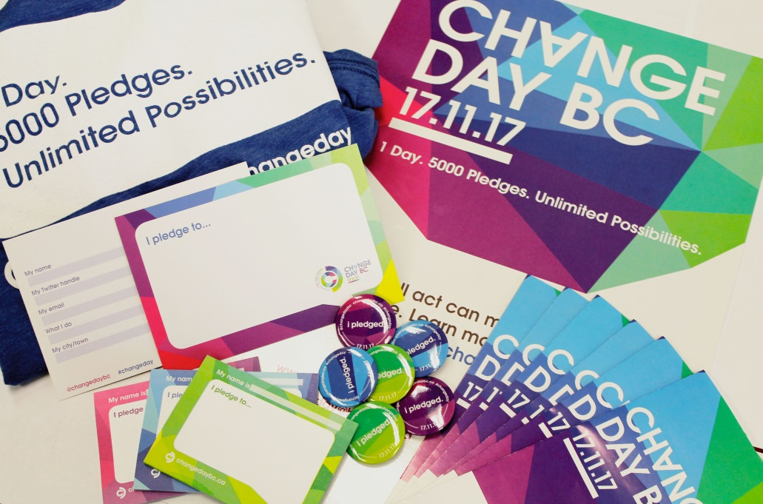
Resources to support you
We’ve created resources to help you along the way:
A Getting Started Kit
Buttons
Post-it notes
Postcards
Templates
And more….

